Slide 1

NoSQL
Module 3

Slide 2
Why NoSQL?
NoSQL stands for Not Only SQL

Slide 3

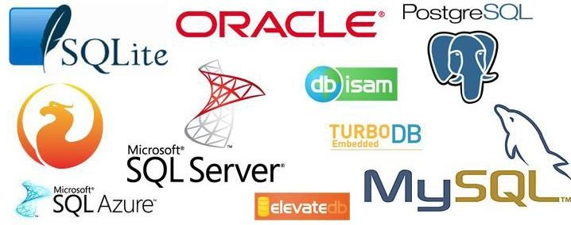
SQL Databases

Slide 4
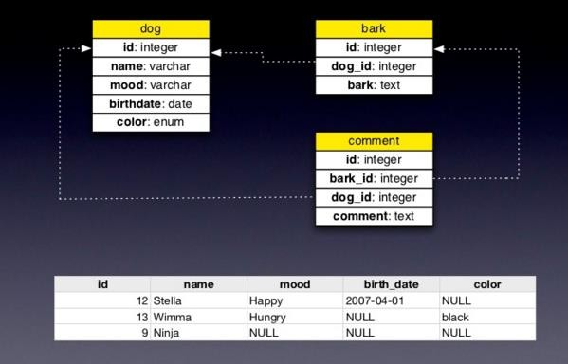
RDMS Database

Slide 5
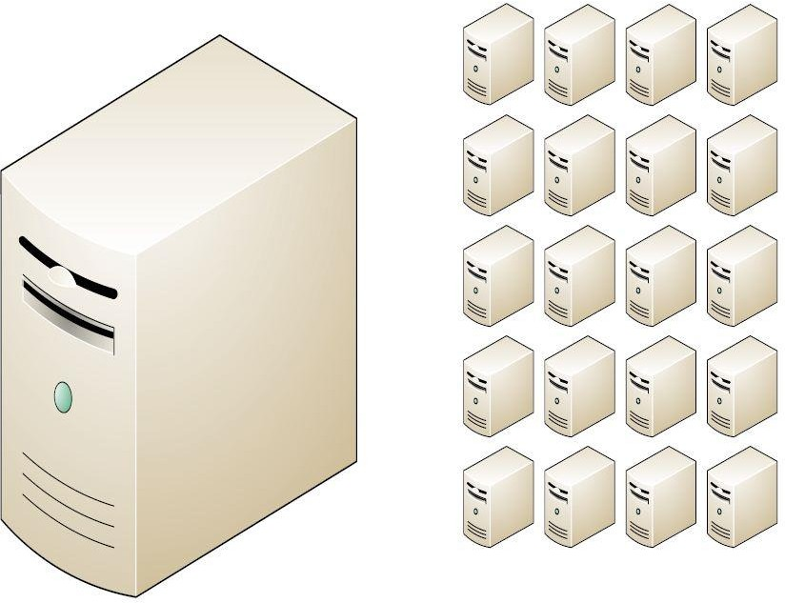
Era of Distributed Computing
But...
Relational databases were not built
for distributed applications.
Because...
Joins are expensive
Hard to scale horizontally
Impedance mismatch occurs
Expensive (product cost, hardware, Maintenance)
And....
It’s weak in:
Speed (performance)
High availability
Partition tolerance

Slide 6
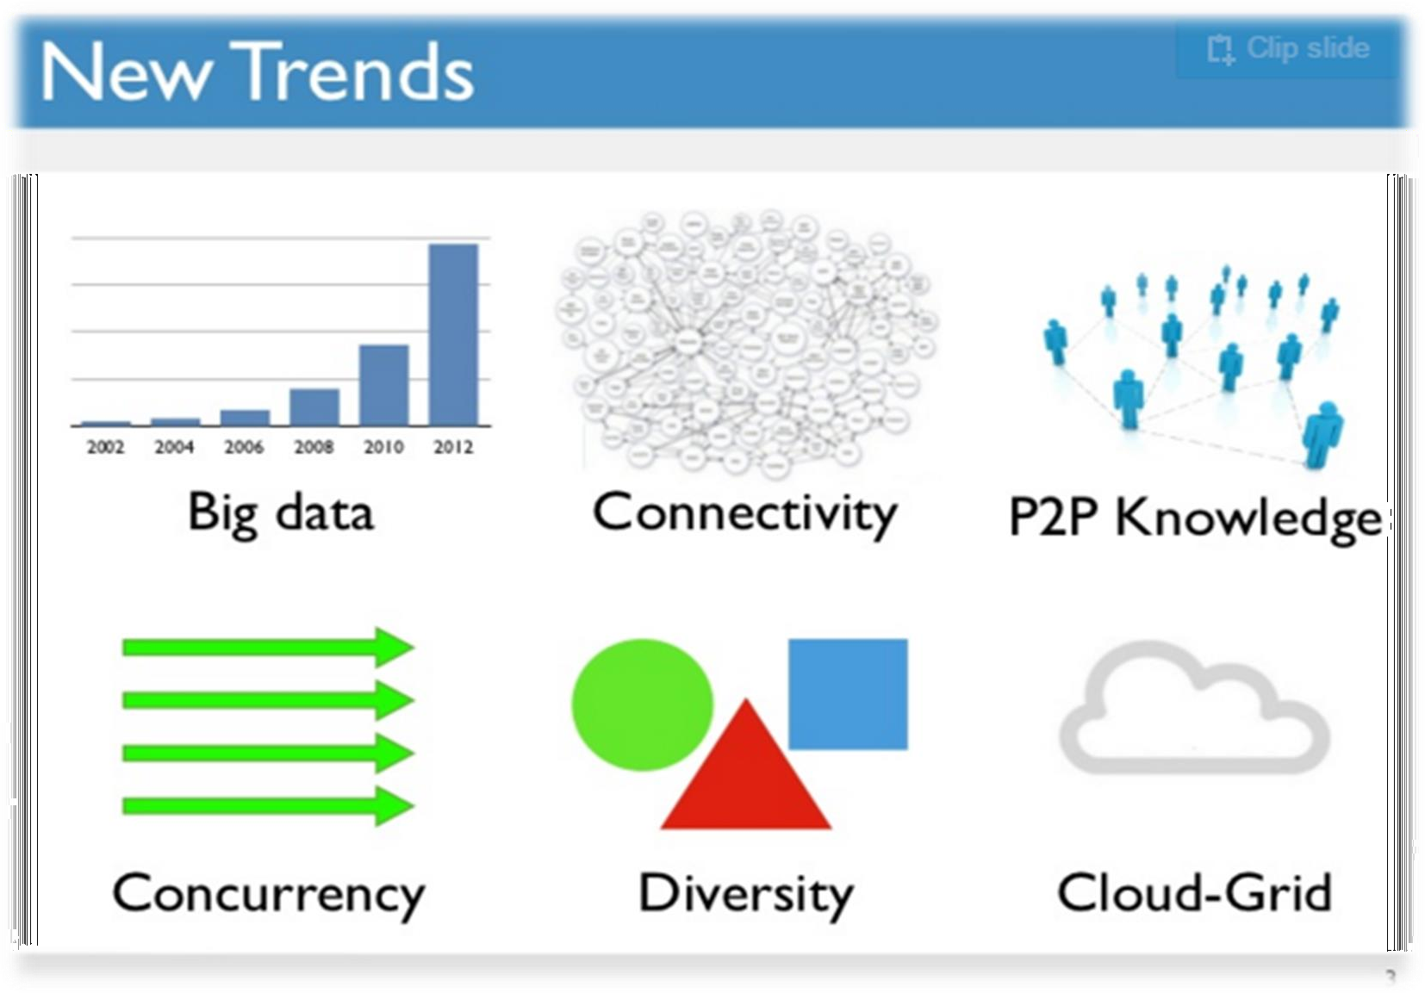
New Trends…

Slide 7
Characteristics Required – Use Cases
Massive write performance.
Fast key value look ups.
Flexible schema and data types.
No single point of failure.
Fast prototyping and development.
Out of the box scalability.
Easy maintenance.

Slide 8
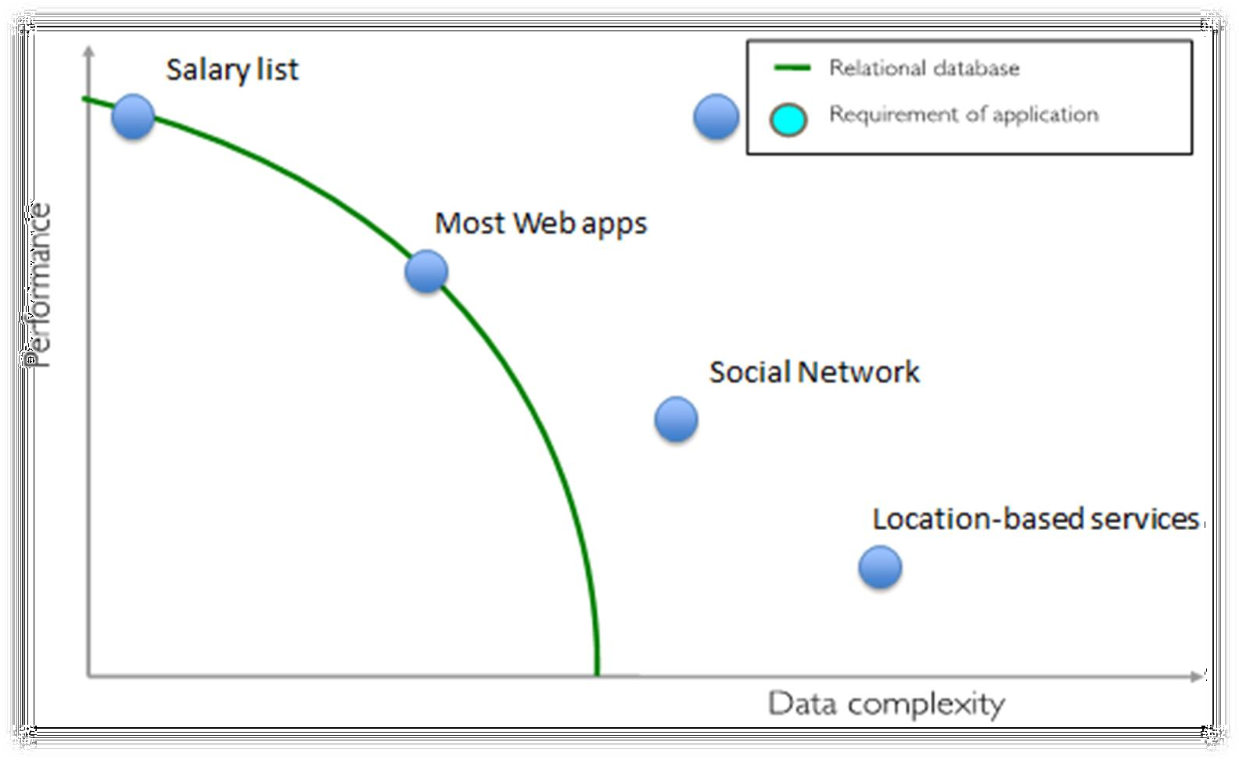
Performance of RDBMS

Slide 9
What went wrong with RDBMS?
Nothing. One size fits all? Not really.
Impedance mismatch.
Object Relational Mapping doesn't work quite well.
Rigid schema design.
Harder to scale.
Replication.
Joins across multiple nodes? Hard.
How does RDMS handle data growth? Hard.
Need for a DBA.

Slide 10
Introduction to NoSQL
NoSQL stands for Not Only SQL

Slide 11
What is NoSQL?
It’s more than rows in tables
It’s free of joins
It’s schema-free
It works on many processors
It uses shared-nothing commodity computers
It supports linear scalability
It’s innovative

Slide 12
What NoSQL is NOT?
It’s not about the SQL language
It’s not only open source
It’s not only big data
It’s not about cloud computing
It’s not about a clever use of RAM and SSD
It’s not an elite group of products

Slide 13
NoSQL Business Drivers
Volume
Velocity
Variability
Agility
The most complex part of building applications using RDBMSs is the process of putting data into and getting data out of the database. If your data has nested and repeated subgroups of data structures, you need to include an object-relational mapping layer.

Slide 14
ACID Semantics
Atomicity: All or nothing.
Consistency: Consistent state of data and transactions.
Isolation: Transactions are isolated from each other.
Durability: When the transaction is committed, state will be durable.
Any data store can achieve Atomicity, Isolation and Durability but do you always need consistency? No.
By giving up ACID properties, one can achieve higher performance and scalability.

Slide 15
Brewer’s CAP Theorem
A distributed system can support only two of the following characteristics:
Consistency
Availability
Partition tolerance
Proven by Nancy Lynch et al. MIT labs.
http://www.cs.berkeley.edu/~brewer/cs262b-2004/PODC-keynote.pdf

Slide 16
Consistency
Consistency: Clients should read the same data. There are many levels of consistency.
Strict Consistency – RDBMS.
Tunable Consistency – Cassandra.
Eventual Consistency – Amazon Dynamo.
Client perceives that a set of operations has occurred all at once – Pritchett
More like Atomic in ACID transaction properties
Notes:
N : Number of nodes with a replica of data.
W: Number of nodes that must acknowledge the update.
R : Minimum number of nodes that succeeds read operation.
W + R > N Strong Consistency
W + R <= N Weak Consistency

Slide 17
Availability
Availability: Data to be available.
Node failures do not prevent survivors from continuing to operate – Wikipedia
Every operation must terminate in an intended response – Pritchett

Slide 18
Partition Tolerance
Partial Tolerance: Data to be partitioned across network segments due to network failures.
the system continues to operate despite arbitrary message loss – Wikipedia
Operations will complete, even if individual components are unavailable – Pritchett

Slide 19
Why not all 3 (C, A and P)?

Slide 20
Scaling Traditional Databases
Traditional RDBMSs can be either scaled:
Vertically (or Up)
Can be achieved by hardware upgrades (e.g., faster CPU, more memory, or larger disk)
Limited by the amount of CPU, RAM and disk that can be configured on a single machine
Horizontally (or Out)
Can be achieved by adding more machines
Requires database sharding and probably replication
Limited by the Read-to-Write ratio and communication overhead

Slide 21
Why Sharding Data?
Data is typically sharded (or striped) to allow for concurrent/parallel accesses
Input data: A large file
Machine 1
Machine 2
Machine 3
Chunk1 of input data
Chunk3 of input data
Chunk5 of input data
Chunk2 of input data
Chunk4 of input data
Chunk5 of input data
E.g., Chunks 1, 3 and 5 can be accessed in parallel

Slide 22
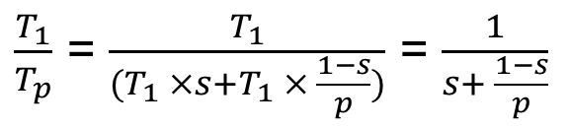
Amdahl’s Law
How much faster will a parallel program run?
Suppose that the sequential execution of a program takes T₁ time units and the parallel execution on p processors/machines takes T_{p} time units
Suppose that out of the entire execution of the program, s fraction of it is not parallelizable while 1-s fraction is parallelizable
Then the speedup (Amdahl’s formula):

Slide 23
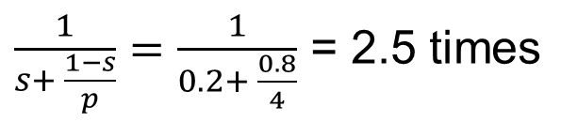
Amdahl’s Law: An Example
Suppose that:
80% of your program can be parallelized
4 machines are used to run your parallel version of the program
The speedup you can get according to Amdahl’s law is:
Although you use 4 processors you cannot get a speedup more than 2.5 times!

Slide 24
Real Vs. Actual Cases
Amdahl’s argument is too simplified
In reality, communication overhead and potential workload imbalance exist upon running parallel programs
Serial
20
80
Serial
20
80
Parallel
20
20
Parallel
20
20
Process 1
Process 1
Process 2
Process 2
Cannot be parallelized
Process 3
Process 3
Cannot be parallelized
Can be parallelized
Process 4
Can be parallelized
Process 4
Communication overhead
Load Unbalance
1. Parallel Speed-up: An Ideal Case
2. Parallel Speed-up: An Actual Case

Slide 25
Some Guidelines
Here are some guidelines to effectively benefit from parallelization:
Maximize the fraction of your program that can be parallelized
Balance the workload of parallel processes
Minimize the time spent for communication

Slide 26
Why Replicating Data?
Replicating data across servers helps in:
Avoiding performance bottlenecks
Avoiding single point of failures
And, hence, enhancing scalability and availability

Slide 27

Why Replicating Data?
Replicating data across servers helps in:
Avoiding performance bottlenecks
Avoiding single point of failures
And, hence, enhancing scalability and availability
Main Server
Replicated Servers

Slide 28
But, Consistency Becomes a Challenge
An example:
In an e-commerce application, the bank database has been replicated across two servers
Maintaining consistency of replicated data is a challenge
Event 1 = Add $1000
Event 2 = Add interest of 5%
1
2
Bal=2000
4
Bal=2100
Bal=1000
3
Bal=1000
Bal=1050
Bal=2050
Replicated Database

Slide 29

The Two-Phase Commit Protocol
The two-phase commit protocol (2PC) can be used to ensure atomicity and consistency
Phase I: Voting
VOTE_REQUEST
VOTE_COMMIT
Participant 1
Database Server 1
VOTE_REQUEST
VOTE_COMMIT
Coordinator
Participant 2
Database Server 2
VOTE_COMMIT
VOTE_REQUEST
Participant 3
Database Server 3

Slide 30
The Two-Phase Commit Protocol
The two-phase commit protocol (2PC) can be used to ensure atomicity and consistency
Phase II: Commit
GLOBAL_COMMIT
LOCAL_COMMIT
Participant 1
Database Server 1
GLOBAL_COMMIT
LOCAL_COMMIT
Coordinator
Participant 2
Database Server 2
GLOBAL_COMMIT
LOCAL_COMMIT
“Strict” consistency, which limits scalability!
Participant 3
Database Server 3

Slide 31
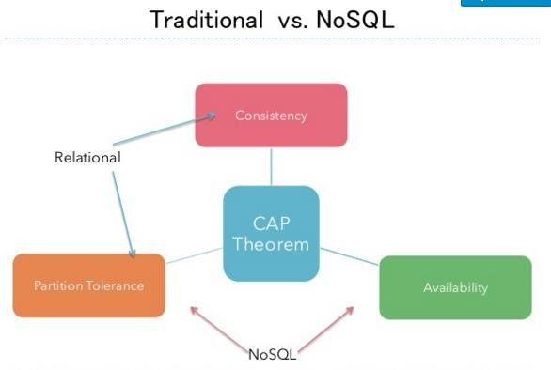
Two practical alternatives

Slide 32
BASE, an ACID Alternative
Almost the opposite of ACID.
Basically Available: Nodes in a distributed environment can go down, but the whole system shouldn’t be affected.
Soft State (scalable): The state of the system and data changes over time.
Eventual Consistency: Given enough time, data will be consistent across the distributed system.

Slide 33
A Clash of cultures
ACID:
Strong consistency.
Less availability.
Pessimistic concurrency.
Complex.
BASE:
Availability is the most important thing. Willing to sacrifice for this (CAP).
Weaker consistency (Eventual).
Best effort.
Simple and fast.
Optimistic.

